Slide 1
Review of Probability

Slide 2
Axioms of Probability Theory
Pr(A) denotes probability that proposition A is true. (A is also called event, or random variable).

Slide 3
A Closer Look at Axiom 3
B

Slide 4
Using the Axioms to prove new properties
We proved this

Slide 5
Probability of Events
Sample space and events
  Sample space S: (e.g., all people in an area)
  Events E1 ⊆ S: (e.g., all people having cough)
  E2 ⊆ S: (e.g., all people having cold)
Prior (marginal) probabilities of events
  P(E) = |E| / |S| (frequency interpretation)
  P(E) = 0.1 (subjective probability)
  0 <= P(E) <= 1 for all events
  Two special events: ∅ and S: P(∅) = 0 and P(S) = 1.0
Boolean operators between events (to form compound events)
  Conjunctive (intersection): E1 ^ E2 ( E1 ∩ E2)
  Disjunctive (union): E1 v E2 ( E1 ∪ E2)
  Negation (complement): ~E (E = S – E)
C

Slide 6
Probabilities of compound events
  P(~E) = 1 – P(E) because P(~E) + P(E) =1
  P(E1 v E2) = P(E1) + P(E2) – P(E1 ^ E2)
  But how to compute the joint probability P(E1 ^ E2)?
Conditional probability (of E1, given E2)
  How likely E1 occurs in the subspace of E2
~E
E
E1
E2
E1 ^ E2
Using Venn diagrams and decision trees is very useful in proofs and reasonings

Slide 7
Independence, Mutual Exclusion and Exhaustive sets of events
Independence assumption
  Two events E1 and E2 are said to be independent of each other if
  (given E2 does not change the likelihood of E1)
  It can simplify the computation
Mutually exclusive (ME) and exhaustive (EXH) set of events
  ME:
  EXH:

Slide 8
Random Variables

Slide 9
Discrete Random Variables
X denotes a random variable.
X can take on a finite number of values in
set {x₁, x₂, …, x_{n}}.
P(X=x_{i}), or P(x_{i}), is the probability that the random variable X takes on value x_{i}.
P( ) is called probability mass function.
E.g.
.
These are four possibilities of value of X. Sum of these values must be 1.0

Slide 10
Discrete Random Variables
Finite set of possible outcomes
X binary:

Slide 11
Continuous Random Variable
Probability distribution (density function) over continuous values
5 7

Slide 12
Continuous Random Variables
X takes on values in the continuum.
p(X=x), or p(x), is a probability density function (PDF).
E.g.
p(x)
x

Slide 13
Probability Distribution
Probability distribution P(X|ξ)
  X is a random variable
    Discrete
    Continuous
  ξ is background state of information

Slide 14
Joint and Conditional Probabilities
Joint
  Probability that both X=x and Y=y
Conditional
  Probability that X=x given we know that Y=y

Slide 15
Joint and Conditional Probabilities
Joint
  Probability that both X=x and Y=y
Conditional
  Probability that X=x given we know that Y=y

Slide 16
Joint and Conditional Probability
P(X=x and Y=y) = P(x,y)
If X and Y are independent then
P(x,y) = P(x) P(y)
P(x | y) is the probability of x given y
P(x | y) = P(x,y) / P(y)
P(x,y) = P(x | y) P(y)
If X and Y are independent then
P(x | y) = P(x)
divided

Slide 17
Law of Total Probability
Discrete case
Continuous case

Slide 18
Rules of Probability: Marginalization
Product Rule
Marginalization
X binary:

Slide 19
Gaussian, Mean and Variance
N(μ, σ)

Slide 20
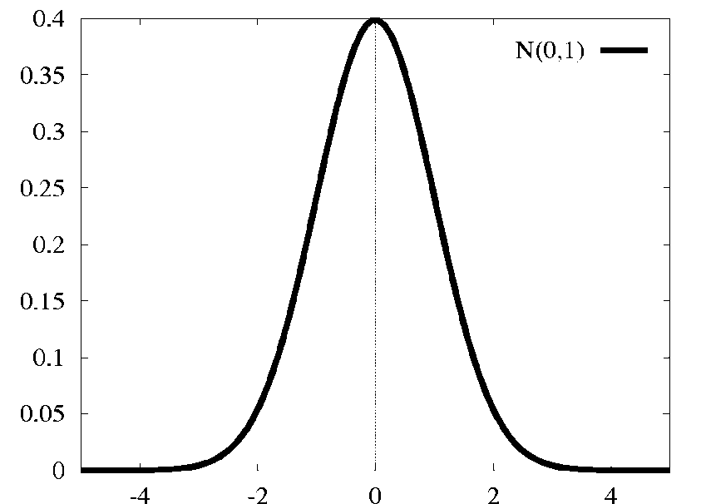
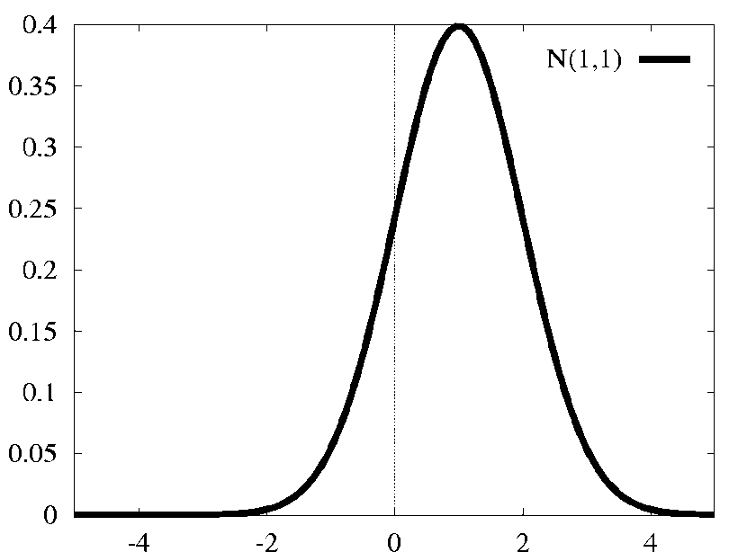
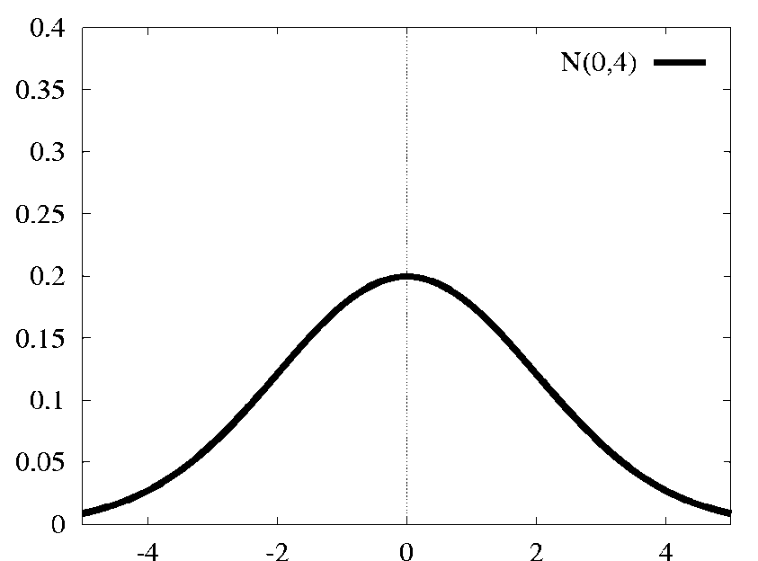
Gaussian (normal) distributions
N(μ, σ)
N(μ, σ)
different mean
different variance

Slide 21
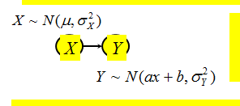
Gaussian networks
Each variable is a linear function of its parents,
with Gaussian noise
Joint probability density functions:
X
Y
X
Y

Slide 22
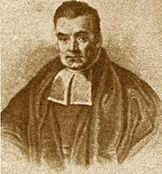
Reverend Thomas Bayes
(1702-1761)
Clergyman and mathematician who first used probability inductively.
These researches established a mathematical basis for probability inference

Slide 23
Bayes Rule

Slide 24
10/40 = probability that you smoke if you have cancer = P(smoke/cancer)
10/100 = probability that you have cancer if you smoke
100 People who smoke
40 People who have cancer
1000-100 = 900 people who do not smoke
1000-40 = 960 people who do not have cancer
10 People who smoke and have cancer
B
E = smoke, H = cancer
Prob(Cancer/Smoke) =
P (smoke/Cancer) * P (Cancer) / P(smoke)
All people = 1000
P(smoke) = 100/1000
P(cancer) = 40/1000
P(smoke/Cancer) = 10/40 = 25%
Prob(Cancer/Smoke) = 10/40 * 40/1000/ 100 = 10/1000 / 100 = 10/10,000 =/1000 = 0.1%

Slide 25
10/40 = probability that you smoke if you have cancer = P(smoke/cancer)
100 People who smoke
40 People who have cancer
10/100 = probability that you have cancer if you smoke
10 People who smoke and have cancer
1000-100 = 900 people who do not smoke
1000-40 = 960 people who do not have cancer
B
E = smoke, H = cancer
Prob(Cancer/Smoke) =
P (smoke/Cancer) * P (Cancer) / P(smoke)
All people = 1000
P(smoke) = 100/1000
P(cancer) = 40/1000
P(smoke/Cancer) = 10/40 = 25%
Prob(Cancer/Smoke) = 10/40 * 40/1000/ 100 = 10/1000 / 100 = 10/10,000 = 1/1000 = 0.1%
E = smoke, H = cancer
Prob(Cancer/Not Smoke) =
P (Not smoke/Cancer) * P (Cancer) / P(Not smoke)
Prob(Cancer/Not smoke) = 30/40 * 40/100 / 900 = 30/100*900 = 30 / 90,000 = 1/3,000 = 0.03 %

Slide 26
Bayes’ Theorem with relative likelihood
In the setting of diagnostic/evidential reasoning
  Know prior probability of hypothesis
  conditional probability
  Want to compute the posterior probability
Bayes’ theorem (formula 1):
If the purpose is to find which of the n hypotheses
is more plausible given , then we can ignore the denominator and rank them, use relative likelihood

Slide 27
Relative likelihood
can be computed from and , if we assume all hypotheses are ME and EXH
Then we have another version of Bayes’ theorem:
where , the sum of relative likelihood of all n hypotheses, is a normalization factor

Slide 28
Naïve Bayesian Approach
Knowledge base:
Case input:
Find the hypothesis with the highest posterior probability
By Bayes’ theorem
Assume all pieces of evidence are conditionally independent, given any hypothesis

Slide 29
absolute posterior probability
The relative likelihood
The absolute posterior probability
Evidence accumulation (when new evidence is discovered)

Slide 30
Bayesian Networks and
Markov Models – applications in robotics
Bayesian AI
Bayesian Filters
Kalman Filters
Particle Filters
Bayesian networks
Decision networks
Reasoning about changes over time
  Dynamic Bayesian Networks
  Markov models

